Slide 1
Networking Concepts Template
A Hyperlink Presentation

Slide 2
Table of Contents
Some Useful Documentation
Some Basic Concepts (Taranpreet)
Web Servers & Web Pages (Tejveer)
Domain Names & IP Addresses (Tejveer)
Mail Servers & Other Types of Servers (Raymond)
Network Routing & ISPs (Daksha)
Local Area & Wide Area Networks & VPNs (Daksha)

Slide 3


1) Some Useful Documentation
How to use Hyperlinks in PowerPoint
https://www.ispringsolutions.com/blog/user-guide-for-non-linear-presentations
Home

Slide 4
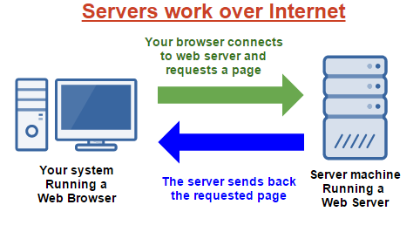

2) Some Basic Concepts
Section Topics
Client Server Model
Peer-To-Peer Model
Hyperlinks
Packets & Data
Firewalls
Basic Concepts
Home

Slide 5
2.1) Client Server Model
Explain the Client Server Model
What is the Client
From Dictionary.com Client means “A person or organization using the services of a lawyer or other professional person or company.”
What is the Server
Server means that a computer or a computer program that has a centralized resource in a network.
Provide an example of an application that uses the Client Server Model
First example is Hypertext Transfer Protocol (HTTP)
Second example is Domain Name system (DNS)
Last example is simple mail Transfer Protocol (SMTP)
Basic Concepts
Home

Slide 6
2.2) Peer-To-Peer Model
Explain the Peer-To-Peer Model
What is a Peer
peers are connected with each via the internet
How is it different from a Client Server Model
The main differences is the data management. Peer-to-peer has its own data and application.
Provide an example of an application that uses the Peer-To-Peer Model
First example is a server based network.
Second example is a peer-to-peer based network.
Basic Concepts
Home

Slide 7
2.3) Hyperlinks
What is a Hyperlink?
A Hyperlink is a link from a hypertext file.
How are Hyperlink related to Web Pages?
Hyperlink are similar with web pages because they both lead the reader to click or tap the link.
How are Hyperlinks related to this PowerPoint document?
Hyperlinks are related to PowerPoint doc because Hyperlink are also like normal links. They can be added normally to any doc.
Basic Concepts
Home

Slide 8
2.4) Packets & Data
What is a Data Packet?
Data packet is a unit of data. They travel along the network path.
What happens to a message (or data) when it is sent across the Internet?
When data travels, they travel in packets. Whenever someone sends something to another person, the message breaks up into packets.
Basic Concepts
Home

Slide 9
2.5) Firewalls
What is a Firewall?
A firewall protects your computer system from unauthorized access.
How does a Firewall protect your computer?
Firewall has a piece of hardware or software that helps prevent malware and malicious attacks from entering the computer though the internet.
How does a Firewall protect remote servers?
They protect by filtering incoming and outgoing network traffic based on a set of user-defined rules.
Basic Concepts
Home

Slide 10
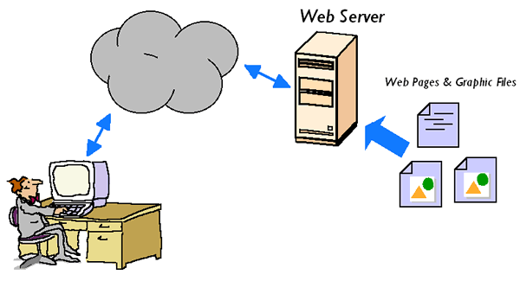

3) Web Servers & Web Pages
Section Topics
HTML
Browsing A Web Page
Web Client Hardware & Software
Web Server Hardware & Software
Web Servers
Home

Slide 11
3.1) HTML & Web Pages
What does HTML stand for?
Hypertext Markup Language
How is HTML related to Web Pages?
It is the base of the web page.
What are some examples of HTML tags used in Web Pages?
<h1>,<p>,<br>,
What are some other languages used in Web Pages?
Javascript, Php, Cascading style sheet.
Web Servers
Home

Slide 12
3.2) Browsing a Web Page
What happens when you browse a web page?
What are the main steps?
The browser sends an HTTP request to the server, asking it to send a copy of the website to the user. “This message, and all other data sent between the client and the server, is sent across your internet connection using TCP/IP”.
Web Servers
Home

Slide 13
3.4) Web Client Hardware & Software
What does a Web Browser do?
A web browser is a software program that allows a user to locate, access, and display web pages. Some common browsers are Google chrome, Opera, Safari, Internet explorer, Microsoft Edge and etc.
What are some common web browsers?
How are they different?
Most browsers are similar to each other, they are usually used to access and display web pages. Some browsers are different because some have different features and different things they are compatible with/can support.
What are some other types of Web Clients?
It can be a program, email clients, safari, opera, microsoft edge, google chrome
Is there any special Hardware or Software required to run a web client?
You only need the basic technology like a cpu, network, gpu and etc to run a web client, unless you are creating a database or something similar then you will need better specs and different softwares. There are also some browsers that only work on certain devices like safari which only works on apple devices.
Web Servers
Home

Slide 14
3.4) Web Server Hardware & Software
What does a Web Server do?
On the hardware side,It is a computer that stores the websites web server software and a websites component files (HTML DOCS, Images). or it on the software side, it includes several parts that control how web user access hosted files.
Where are Web Servers located in the Network / Internet?
Most of the time websites are hosted on a set of servers called a server farm which may be located in one or multiple different data centres.
What special Software is needed for a Web Server
Yes there is software that is needed to create a web server, for example Webstar, active server pages and etc.
What special Hardware is needed for a Web Server
There is no special hardware needed for a web server, mainly all you need is a dedicated server computer.
Web Servers
Home

Slide 15


4) Domain Names & IP Addresses
Section Topics
What is a Domain Name?
It is your websites name, it is the address that allows users to access your website. It is used to find and identify computers on networks. Computers use ip address which are series of numbers, but since they are hard to remember domain names were created.
What is an IP Address?
An internet protocol address is a string of numbers that are separated by periods used to represent computers on the internet.
Controls the assignment of Names & Addresses?
ICANN (Internet Corporation for Assigned Names and Numbers) is a private company that controls the allocation of ip address and domain name management.
Domain Names
Home

Slide 16
4.1) What is a Domain Name?
What is a Domain Name?
It is your websites name, it is the address that allows users to access your website. It is used to find and identify computers on networks. Computers use ip address which are series of numbers, but since they are hard to remember domain names were created.
How are Domain Names related to Web Pages?
Domain names are used in urls to identify web pages. This is because domain names basically represent the ip address.
How does my computer find and use Domain Names?
When a web address is searched it then uses the domain name and converts it into a ip address then it initiates a process that begins to locate the requested page.
Domain Names
Home

Slide 17
4.2) What is an IP Address?
What is an IP Address?
An internet protocol address is a string of numbers that are separated by periods used to represent computers on the internet.
What is the difference between IPv4 and IPv6?
IPv4 is a 32 bit numeric address that is written in decimal as four numbers separated by periods. IPv6 addresses are 128-bit IP address written in hexadecimal and separated by colons.
How does my computer convert a Domain Name to an IP Address?
Every web server requires a Domain Name System (DNS) server to translate domain names into IP addresses.
Domain Names
Home

Slide 18
4.3) Who Controls Domain Names?
Who Owns and Controls Domain Names and IP Addresses?
ICANN (Internet Corporation for Assigned Names and Numbers) is a private company that controls the allocation of ip address and domain name management.
How can I register a Domain Name for my own use?
You register the name at an organization called ICANN and pay a registration fee which will have to be paid every year and pick your domain name.
Domain Names
Home

Slide 19


5) Mail & Other Servers
Section Topics
Mail Servers
File Servers
Database Servers
Other Types of Servers
Servers
Home

Slide 20
5.1) Mail Servers
Downloaded Mail
What is SMTP / POP3?
SMTP stands for simple mail transfer protocol, a data transmission format used to send and receive mail
POP3 us a protocol for receiving email by downloading it to a local computer from an internet data server.
What are some common Mail Clients
Some popular mail clients are gmail, outlook, apple mail, yahoo, and thunderbird.
What are some advantages of downloaded mail?
All mail files are accessed by a server, and doesn’t take up local space on your PC. It’s a 2 way connection with access as long as there is an internet connection. You can sort though, recover, and delete online mail files with ease.
Servers
Home

Slide 21

5.1) Mail Servers
Web Based Mail
What are some common Browser Based Mail Services
Some browser based mail services include gmail, yahoo, outlook, apple mail, etc...
What are some advantages of browser based mail?
some common advantages of browser based mail is that you would get the latest updates on new mail arriving, easy access to files and links, and you can have organization tools such as filters and easy deletion from seperate servers.

Slide 22
5.1) Mail Servers
Mail Servers
Where is mail stored in the Internet?
Mail is stored on the provider’s data servers, to be sent or stored for later use for the consumers to look through and delete.
How is male delivered across the Internet?
mail is delivered via internet, and you can access your mail as long as you have a stable connection with access to either the application or web browser.
What special Hardware & Software is required for a mail server?
You need enough hardware to be able to store thousands or even millions of data coming into the servers, and have enough storage in order to store all of those mail packages for sending out to the client’s computers.

Slide 23
5.2) File Servers
Cloud Based Storage
What are some Cloud Storage Services (applications) ?
some cloud storage services include icloud, google drive, dropbox, microsoft Azure, etc...
What are some advantages of cloud based storage over local storage?
unlimited storage capacities, and less hassle of having local storage full due to mass file amounts. Backups can also be uploaded on a regular basis.
File Servers
What special Hardware & Software is required for a file server?
You need a lot of storage, and on top of that a great internet connection for all of those who want to upload their files onto your data servers for later use.
Servers
Home

Slide 24
5.3) Database Servers
What is a Database?
What is SQL?
Structured Query Language is what SQL stands for, and this language is used by servers to communicate throughout a database.
What type of information is stored in a database?
Information that each and every user needs in order to fulfill the needs of the consumer and what the company is providing the database for.
How are databases used and combined with web pages?
Databases allow users to have their own unique data set, and have personal data assigned to each user safely and securely.
Database Servers
What are some common Database products?
Oracle RDBMS, IBM DB2, Microsoft SQL server, Teradata, MySQL, SAP, ADABAS
What special Hardware & Software is required for a database server?
Everything that basic computers would need, with a more powerful CPU, and more RAM to make the job of controlling data more efficient. With controlling data, you also need a lot of storage capabilities.
Servers
Home

Slide 25
5.4) Other Servers
Describe some other types of internet servers not covered by the slides above.
Some other data servers that are not listed, are proxy servers, which store proxy configurations of each user that people can go onto and use.
Message servers which allow users to communicate via text in real time applications, assuming that users have constant connection to the internet.
Application servers that are used for different operating systems to store their unique applications and the software that runs the applications for them to work for users.
Servers
Home

Slide 26
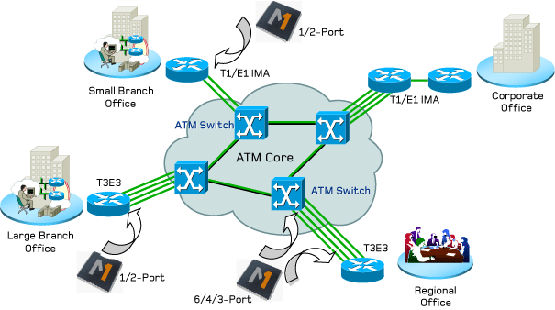

6) Network Routing & ISPs
Section Topics
Internet Service Provider (ISP)
Internet Connection Technologies
Network Routers & Switches
Networks
Home

Slide 27
6.1) Internet Service Providers (ISPs)
What is an ISP?
An Internet Service Provider (ISP) is the industry term for the company that is able to provide you with access to the Internet, typically from a computer. If you hear someone talking about the Internet and they mention their "provider," they're usually talking about their ISP.
What are some common ISPs people use in the Toronto Area?
ISPS such as Rogers, Bell, Telus, etc
How is an ISP different from a Internet application / service?
An ISP is different from an application or service since an ISP is usually an organization that provides services such as Wifi. For example you can download an application or service but you can’t download an ISP.
Networks
Home

Slide 28
6.2) Internet Connection Technologies
Describe some internet connection technologies using telephone lines.
Dial-up access: connecting a device to a network via a modem and a public telephone network. Dial-up access is really just like a phone connection, except that the parties at the two ends are computer devices rather than people.
Multilink dial-up: Multilink PPP is a communications protocol that enables a personal computer (PC) to use two PPP (Point-to-Point Protocol) communications ports as if they were a single port of greater bandwidth.
Describe some internet connection technologies using Wi-Fi.
Internet Router: A router is connected to at least two networks, commonly two LANs or WANs or a LAN and its ISP's network. Routers are located at gateways, the places where two or more networks connect, and are the critical device that keeps data flowing between networks and keeps the networks connected to the Internet.
Wireless Adapters: A wireless adapter is a hardware device that is generally attached to a computer or other workstation device to allow it to connect to a wireless system. Before the advent of consumer devices with built-in Wi-Fi connectivity, devices required the use of wireless adapters to connect to a network.
Describe some internet connection technologies using fibre optics cables.
Direct fiber: Fiber that leaves the central office and is attached directly to one customer. This provides the greatest bandwidth but is more expensive.
Shared fiber: Similar to direct fiber except that as the fiber gets close to the premises of nearby customers, it's split into others fibers for those users.
Networks
Home

Slide 29
6.3) Network Routers & Switches
What is a "Routing Table"?
In computer networking a routing table, or routing information base, is a data table stored in a router or a networked computer that lists the routes to particular network destinations, and in some cases, metrics associated with those routes.
How are data packets sent through the internet between a client and a server?
A network sends bytes between a client and a server
What special hardware & software is required for a network router / switch?
Internet Modem, Ethernet Hub/Switch, Wireless Router.
Networks
Home

Slide 30
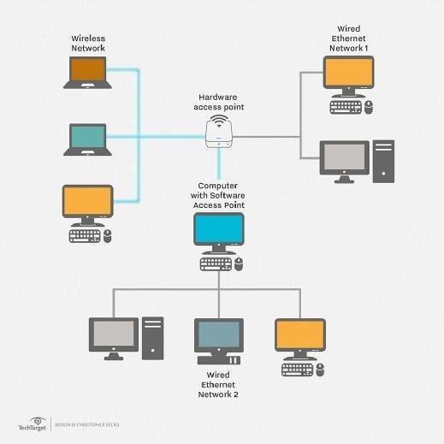
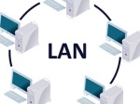
7) Types of Networks
Section Topics
Local Area Networks (LAN)
Wide Area Networks (WAN)
Virtual Private Networks (VPN)
LANs
Home

Slide 31
7.1) Local Area Networks (LAN)
What is a Local Area Network?
A local area network (LAN) is a group of computers and associated devices that share a common communications line or wireless link to a server.
What is the purpose of a Local Area Network?
Typically, a LAN encompasses computers and peripherals connected to a server within a distinct geographic area such as an office or a commercial establishment.
What types of applications, servers, and computers are connected to a LAN?
Computers and other mobile devices use a LAN connection to share resources such as a printer or network storage.
LANs
Home

Slide 32
7.2) Wide Area Networks (WAN)
What is a Wide Area Network?
A wide area network (WAN) is a network that exists over a large-scale geographical area.
What is the purpose of a Wide Area Network?
A WAN connects different smaller networks, including local area networks (LAN) .
What types of applications, servers, and computers are connected to a WAN?
Computers and users in one location can communicate with computers and users in other locations. WAN implementation can be done either with the help of the public transmission system or a private network.
LANs
Home

Slide 33
7.3) Virtual Private Networks (VPN)
What is a Virtual Private Network?
A virtual private network extends a private network across a public network, and enables users to send and receive data across shared or public networks as if their computing devices were directly connected to the private network.
How is a VPM different from a LAN / WAN?
A VPN is a private network unlike a LAN or WAN which is why it is considered to be so secure.
How could you use a VPN to increase the security of services you use in the Internet?
VPNs, or Virtual Private Networks, allow users to securely access a private network and share data remotely through public networks. Much like a firewall protects your data on your computer, VPNs protect it online.
LANs
Home

